Slide 1

CAPSTONE PROJECT
Python Memory Management prediction service for code
snippets
Course code: CSA1461
Course: Compiler Design For CFL
PRESENTED BY:
Rohit P S (192224082)
V. Kesava (192224077)
M. Dinesh (192211763)

Slide 2

Introduction :
1. This project outlines the importance of efficient memory management in Python development and highlights the need for tools and services to assist developers in this aspect.
2. The proposed Python Memory Management Prediction Service aims to fill this gap by providing developers with valuable insights into memory usage behavior, ultimately contributing to enhanced performance, optimized resource utilization, and improved software quality.
3.The service leverages machine learning algorithms trained on vast datasets of Python code snippets and their corresponding memory usage patterns.
4. In Python, memory management is handled by the Python runtime, primarily through mechanisms such as reference counting and garbage collection.

Slide 3
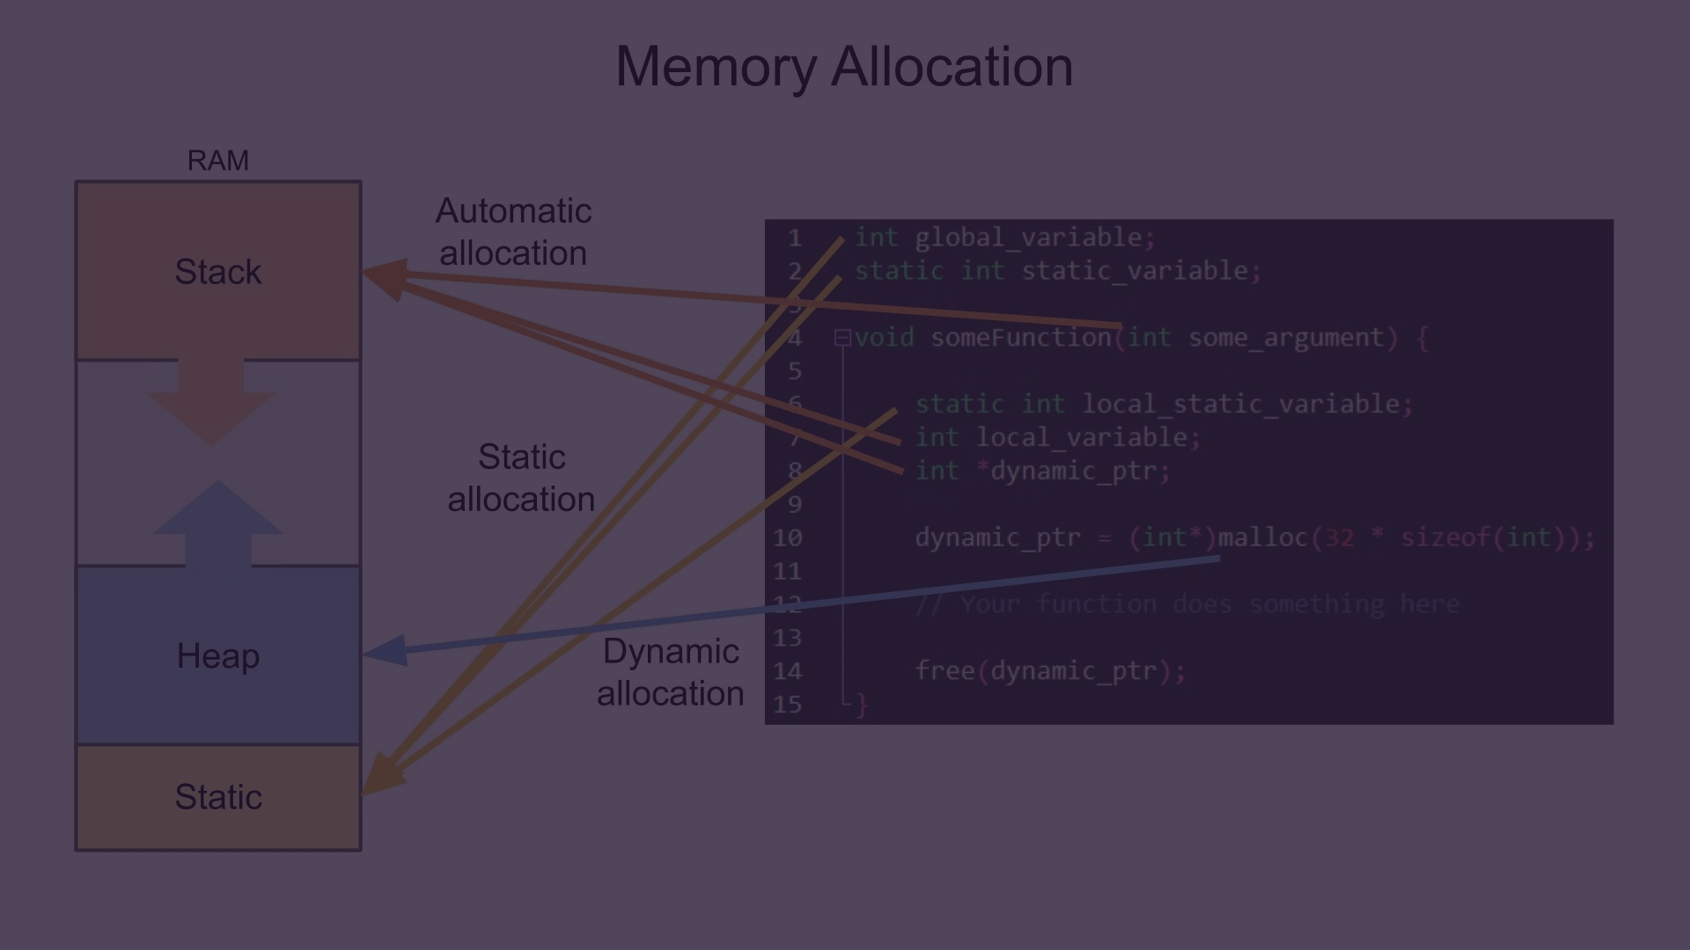
Initial stage:
Memory Management Strategies
Optimization Techniques
Project Scope
Contiguous Memory Allocation: In this strategy, memory is divided into partitions, and processes are allocated contiguous blocks of memory.
Dynamic Memory Allocation: Systems may also dynamically allocate memory during runtime using techniques like malloc() and free() in C, or new and delete operators in C++.
Memory Fragmentation: Memory fragmentation occurs when memory is allocated and deallocated in a way that leaves small gaps between allocated blocks of memory.
Enhance algorithm efficiency through analysis, design, and heuristics.
Code Optimization: Improve code efficiency via loop optimization, data structure choice, and inlining.Utilize compiler optimizations for streamlined machine code.
Memory Optimization:
Optimize memory usage with pooling, alignment,
compression, and access pattern optimization.
Analyze memory consumption patterns of Python code snippets.
Develop predictive models using machine learning algorithms.
Evaluate model accuracy and performance across diverse code scenarios.

Slide 4
Data Collection and Preparation
The data sources for this project are taken from databases like the ACM digital library, IEEE Xplore, and Google Scholar, which contain a wealth of research papers on memory management techniques in compiler design
To ensure the quality and relevance of the collected data, a thorough data cleansing and preprocessing step has been undertaken. The research papers and other sources have been carefully inspected to verify their direct relevance to the specific memory management techniques being analyzed.
Exploratory Data Analysis (EDA)
The next step in the project involves conducting a comprehensive exploratory data analysis (EDA) on the collected data. The performance characteristics of different memory management strategies, such as static, stack, and heap, will be analyzed in-depth based on the data gathered from research papers and compiler benchmarks.
To facilitate this analysis, the team will implement various visualization techniques, including histograms, boxplots, and kernel density plots. These visualizations will help the team gain a deeper understanding of the distribution of key variables, such as execution time, memory usage, and cache misses, for each memory management strategy.

Slide 5

Proposed Design Work
1
Identify the Key Components
2
Functionality
This design employs feature engineering to capture program characteristics relevant to memory usage patterns.
The Random Forest model, trained on historical data, predicts the performance impact of different strategies for a new program.
The strategy selection module, informed by predictions and program requirements, recommends the optimal approach.
The Feature Engineering Module extracts features from the input program. The extracted features are used to train the Random Forest Model.
For a new program, the features are extracted and fed into the trained model. The Random Forest Model predicts the performance impact of each memory management strategy.

Slide 6



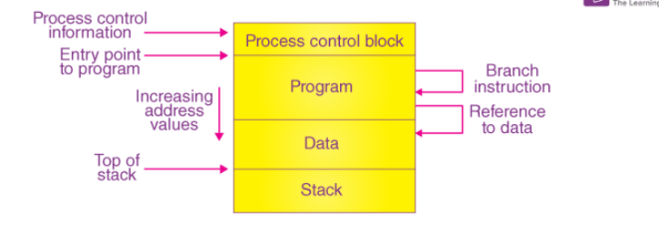
Architectural Design
Modular Design
Open-Source Libraries
Cloud-Based Training
Each component is independent, facilitating development, testing, and maintenance.
Utilization of open-source libraries like scikit-learn for feature engineering and Random Forest implementation.
Leverage cloud platforms like Google Collab or Amazon Sage Maker for efficient model training on large datasets and integrated the design as an API within the compiler to enable seamless strategy selection during compilation.

Slide 7
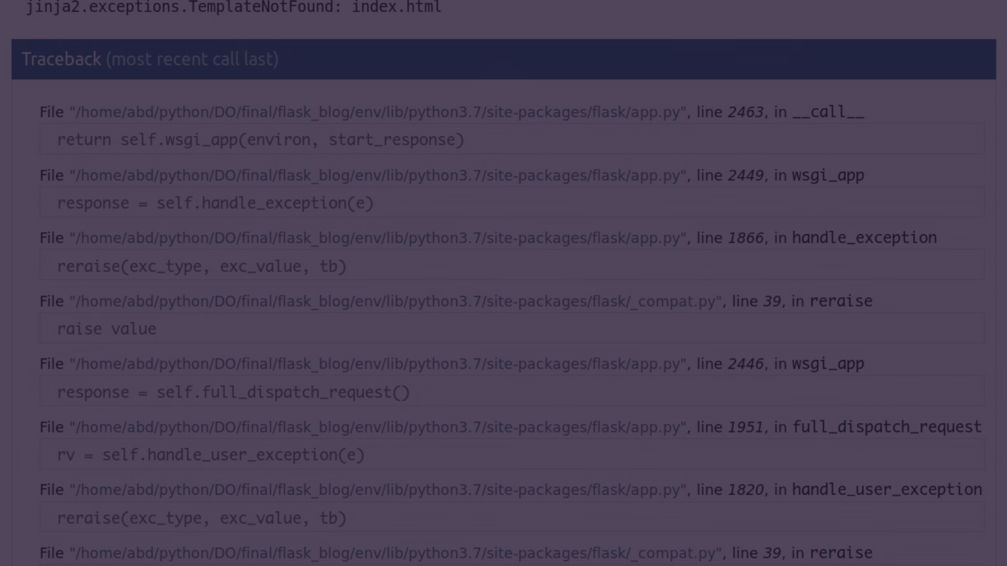
Code
import pandas as pd
from sklearn.feature_extraction.text
import TfidfVectorizerfrom sklearn.ensemble
import RandomForestClassifier
from sklearn.model_selection
import train_test_split
from sklearn.metrics
import classification_report, accuracy_score
# 1. Load the dataset
dataset = pd.read_csv('memory_management_model.csv')
# 2. Preprocess the data (if necessary)
# 3. Split the dataset into features and
labelsX = dataset['code']
y = dataset['memory_management_technique']
# 4. Extract features from the code snippets
vectorizer = TfidfVectorizer(max_features=1000)

Slide 8
CODE:
# Adjust max_features as neededX_
tfidf = vectorizer.fit_transform(X)
# 5. Split the dataset into training and testing sets
X_train, X_test, y_train, y_test = train_test_split(X_tfidf, y, test_size=0.2, random_state=42)
# 6. Train a machine learning modelmodel = RandomForestClassifier(n_estimators=100, random_state=42)
model.fit(X_train, y_train)
# 7. Evaluate the modely_pred = model.predict(X_test)
print("Accuracy:", accuracy_score(y_test, y_pred))
print("Classification Report:\n", classification_report(y_test, y_pred))

Slide 9
Memory Management Strategies in Compiler Design
This code initializes a Flask application (app) to handle user requests. predict_performance function is placeholder function represents logic for extracting features from the code and making predictions using the trained model.
We need to implement this based on chosen feature engineering and machine learning techniques. replace the placeholder code with your model loading logic.

Slide 10

Future scope:
The proposed solution utilises feature engineering and a machine learning model to predict the performance impact of different memory management strategies on a given program.
The UI facilitates user interaction, allowing them to upload source code, view predicted performance metrics, and receive recommendations for the optimal strategy based on their preferences and constraints.
This design offers several potential benefits, including improved developer productivity, informed decision-making regarding memory management, and potentially enhanced program performance.

Slide 11
Conclusion:
The Python Memory Management Prediction Service presents a promising solution for developers seeking to optimize memory usage and improve performance in Python applications.
By leveraging machine learning algorithms and code analysis techniques, the service offers valuable insights into memory consumption patterns, enabling developers to make informed decisions and proactively address memory-related issues.
With ongoing refinement and innovation, the prediction service holds the potential to evolve into an indispensable tool for memory management in Python and beyond.
While there are challenges and limitations to be addressed, the potential benefits in terms of enhanced productivity, software quality, and resource optimization make the prediction service a valuable asset in the toolkit of Python developers.

